Slide 1
Azure Big Compute Hackfest: Building next generation compute intensive applications with Microsoft Azure
Steve Roach
Global Black Belt
Azure Big Compute
Rob Futrick
Principal Program Manager
Azure Big Compute
Kent Altena
Global Black Belt
Azure Big Compute

Slide 2
Workshop Agenda
Start | Stop | Topic | Presenter
9:00am | 10:00am | Big Compute on Azure | Steve Roach
10:00am | 11:15am | HPC Hands-On Workshop (Break as needed) | Steve Roach
11:15am | 12:15pm | Cycle Cloud Presentation | Rob Futrick
12:15pm | 1:00pm | Lunch
1:00pm | 2:00pm | Azure Batch Presentation | Kent Altena
2:00pm | 2:45pm | Azure Batch Workshop (Break as needed) | Kent Altena
2:45pm | 3:15pm | X-ISS Presentation | Jim Decker
3:15pm | 3:30pm | Wrap-up | Steve Roach

Slide 3
Azure Introduction

Slide 4

Azure regions
Dublin*
Amsterdam
Chicago
Korea Central
40
New York
London
Silicon Valley
Washington DC
Tokyo
US DoD West
Atlanta
US DoD East
Korea South
Osaka
Dallas
HPC/GPU regions
US EAST
US WEST
US SOUTH CENTRAL
US NORTH CENTRAL
EUROPE WEST
EUROPE NORTH
JAPAN EAST
Hong Kong
Chennai
Mumbai*
Singapore
Sydney
Melbourne*
Coming Soon
Notes:
Global – you choose where to run your application
A region is a collection of data centers ..
Biggest global footprint
Keep growing
Paired regions in the geo

Slide 5























































Platform Services
Security & Management
Services Compute
Web and Mobile
Data
Hybrid
Operations
Cloud
Services
Service
Fabric
Web Apps
API Apps
Portal
SQL
Database
Data
Warehouse
DocumentDB
Azure AD
Health Monitoring
Azure Active
Directory
Batch
RemoteApp
AD Privileged
Identity
Management
Mobile
Apps
Logic Apps
Redis
Cache
Azure
Search
Storage
Tables
Azure AD
B2C
Integration
Domain Services
Multi-Factor
Authentication
API
Management
Notification
Hubs
Storage
Queues
BizTalk
Services
Analytics & IoT
Backup
Automation
Hybrid
Connections
Service Bus
Developer Services
HDInsight
Machine
Learning
Stream
Analytics
Data
Lake
Operational
Analytics
Scheduler
Key Vault
Visual Studio
Azure
SDK
Data
Factory
Event
Hubs
Data
Catalog
Import/Export
Media & CDN
Store/
Marketplace
Media Services
Content Delivery
Network (CDN)
VS Online
App
Insights
Mobile
Engagement
Azure Site
Recovery
IoT Hub
VM Image Gallery
& VM Depot
StorSimple
Infrastructure Services
OS/Server Compute
Storage
Networking
Virtual Machines
Container
Service
BLOB Storage
Azure
Files
Premium
Storage
Virtual Network
Load Balancer
DNS
Express
Route
Traffic Manager
VPN Gateway
App
Gateway
Datacenter Infrastructure (24 Regions, 22 Online)
Notes:
Why this Slide:
It shows we have a very broad platform. It about BOTH IaaS and PaaS, that these work together. It shows that we continue to lead in world class IT capabilities and that there’s really nothing missing.
Key Points:
We have already seen how the Azure Platform is IaaS + Pass – but I want you to understand that this is a huge number of capabilities – IT building blocks if you will.
Every one of these blocks you provision anytime, self-service anywhere in the world 24x7. You pay for what you use, you can get more or less anytime and you can fully automate everything…
DON’T spent too much time on this slide – you are going to DEMO (aren’t you!!!)… DON’T go through each block…
Transition to NEXT Slide: Make the build go backwards to show JUST IaaS and then you will go to the demo to show it.

Slide 6
Core services of Azure IaaS
Compute
Storage
Networking
Management
Virtual machines
Availability sets
VM Scale Sets
Etc.
Disks (Standard, premium)
Blob storage (Hot, cool)
Files
Etc.
Virtual networks
VPN, ExpressRoute
Load Balancer
DNS, Traffic Manager
Etc.
Azure Resource Manager (ARM)
Azure Active Directory
Portal
KeyVault etc.

Slide 7
Trust and control
PHYSICAL
Cameras/alarms
Secure by design
24X7 security staff
INFRASTRUCTURE
Operation security controls
Barriers/fencing
Compliance certifications
NETWORK
Two-factor access control
Penetration testing
Days of backup power
DDOS protection, forensics
VM + App
Secure and isolated VNets
Anti-malware
Subnet ACLs
KeyVault
Forced tunneling
Role-based access controls
Logging/auditing
Security appliances
VM Disk,Storage encryption
Multiple virtual NICs
Azure Security Center
Notes:
How we define the trust bounderies for the cloud
Automatically you are protected from DDoS attacks .. In fact we detected more than 100,000 DDoD attempts in last year.
Network isolation – Vnet
Vnet- Manage your secrets with JSM enabled service

Slide 8
















































Azure covers 54 compliance offerings
Azure has the deepest and most comprehensive compliance coverage in the industry
Global
ISO 27017
ISO 22301
SOC 1
Type 2
SOC 2
Type 2
SOC 3
CSA STAR
Self-Assessment
CSA STAR
Certification
CSA STAR
Attestation
ISO 27001
ISO 27018
US Gov
Moderate
JAB P-ATO
High
JAB P-ATO
DoD DISA
SRG Level 2
DoD DISA
SRG Level 4
DoD DISA
SRG Level 5
SP 800-171
Section 508 VPAT
ITAR
CJIS
IRS 1075
FIPS 140-2
Industry
PCI DSS
Level 1
FACT
UK
Shared
Assessments
FISC
Japan
HIPAA / HITECH Act
GxP
21 CFR Part 11
IG Toolkit
UK
CDSA
MPAA
HITRUST
MARS-E
FERPA
GLBA
FFIEC
Regional
EU
Model Clauses
China
GB 18030
New
Zealand
GCIO
ENISA
IAF
Japan CS Mark Gold
Spain
ENS
India
MeitY
Canada
Privacy Laws
Germany IT
Grundschutz
workbook
Argentina PDPA
China
DJCP
UK
G-Cloud
China
TRUCS
Singapore
MTCS
Australia
IRAP/CCSL
Japan My
Number Act
Spain
DPA
Privacy
Shield
Notes:
Feb-2017: Azure compliance coverage includes 54 offerings

Slide 9

Microsoft
Linux
33%
of Azure VMs run Linux

Slide 10







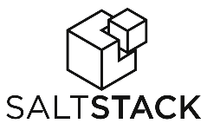



































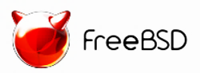

Azure is an open cloud
DevOps
Clients
Management
Applications
PaaS and
DevOps
App frameworks
and tools
Databases and
middleware
Infrastructure
Notes:
We meet our customer with whatever technology they use/want
If you are an IT manager, you ca nenable your dev teams to pick their tools and platforms

Slide 11
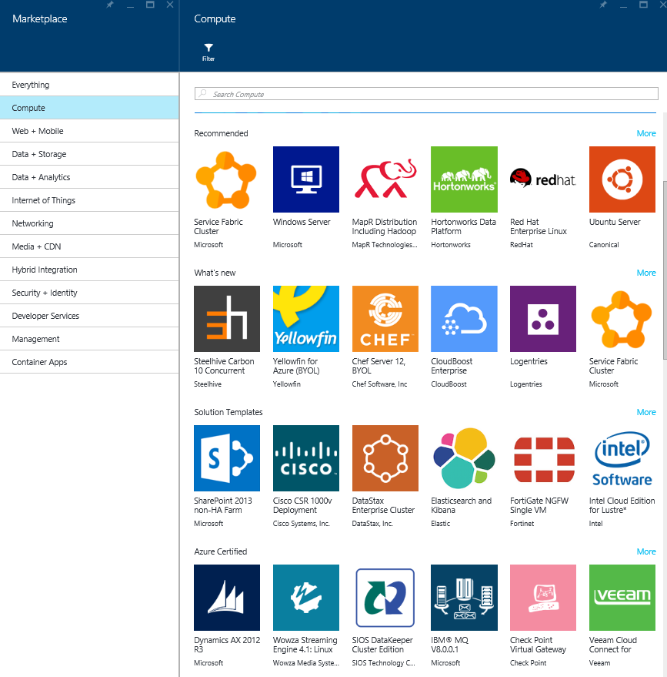
>4000
Certified, pre-configured for Microsoft Azure Solutions in Azure Marketplace
Notes:
Enable partners to sell their software in Azure
Enabled community projects for free

Slide 12
Big Compute on Azure Overview

Slide 13
WHAT IS AZURE BIG COMPUTE?
Risk Simulations
Food & beverages
Automotive
Weather forecasting
Academia
Fluid dynamics
Graphics & rendering
Banking
Oil & Gas
Defense & Aerospace
Oceaneering
Deep Learning
Crash Simulations
HPC
Insurance
Ship engineering
Pharmaceutical
Healthcare
Molecular Modelling
Structural
simulations
Genomics
Chemical engineering
Energy
Engineering & construction
Bio Science

Slide 14
On-premises HPC
On-premises
Demand for HPC infrastructure

Slide 15
Challenges with on-premises HPC
New business demands
Regulations
AI
IOT
Data analytics
Keeping up with business demands
Maximizing your investment
On-premises
Demand for HPC infrastructure
Siloed environments limiting collaboration

Slide 16
Expand your HPC environment to the Cloud
Cloud
The new HPC opportunity
Variable demand
Fixed demand
On-premises
Demand for HPC infrastructure

Slide 17
Build your HPC environment in the Cloud
Cloud
The new HPC opportunity
All demand
Demand for HPC infrastructure

Slide 18
What is HPC all about?
Uses:
Science and research
Genomics & bioinformatics
Climate modeling
Hydrological analysis
Image analysis & processing
Video & audio transcoding
Engineering stress analysis
Automobile crash simulation
Financial risk analysis
Oil and gas production
... and much more!
Many individual tasks need to run to reach the answer
APP
Use many computers/ VMs instead of one
Tasks are assigned to computers/VMs
Independent or coupled tasks
INPUT
OUTPUT
Data is read, computed and written/stored

Slide 19
Two main types of HPC workloads
Embarrassingly parallel:
Nodes don’t need to talk to each other, or very little cross-node communication
Usually a parameter sweep, a job splitting, or a search/comparison through data
Examples: Monte Carlo simulations, image/video rendering, genetic algorithms, sequence matching
→Great workload for the cloud!
Tightly coupled:
Nodes need to talk to each other constantly
Requires a fast interconnection network (low latency and high throughput)
Examples: automotive crash simulation, fluid dynamics, climate modeling, reservoir simulation, manufacturing modeling
→More challenging, but already possible on Azure!
And the focus of this Lab

Slide 20
Azure HPC building blocks
Infrastructure as a service (IaaS): a range of infrastructure and platform offerings, including HPC-class infrastructure, to match the requirements of any type of parallel workload.
Azure Services: a combination of advanced services like Azure Batch, first party Azure services like rendering and AI as a service and partner offered SaaS service on Azure.

Slide 21

Azure Marketplace: HPC applications on Demand
The Azure marketplace brings Azure partner ecosystem to customers around the world
Virtual machines
Simple deployment for pre-packaged solution
A unified location for Azure based offerings from Microsoft and partners
Thousands of offers
Integrated platform experience Streamlined configuration, deployment, and management
Fortune 500 and SMB customers across 86 global markets
Data services
App services
Azure marketplace
AAD apps
Web apps
Notes:
Example: D3View in marketplace

Slide 22
Azure Compute
GPU, CPU, Azure Batch + PaaS Services

Slide 23

Hardware capabilities
Specialized infrastructure
A
H
N
A8-A9 and A10-A11 are performance-tuned VMs that provide bare-metal results
8 or 16 CPU cores per VM
A8-A9 with QDR InfiniBand + RDMA on Windows and Linux
< 3 µsecs latency
32 Gbps throughput (actual)
Fully non-blocking topology to ensure max bandwidth
E5-2670 Sandy Bridge processor
H series
Fastest VMs in the public cloud
8 or 16 CPU cores per VM
H16r and H16mr with FDR InfiniBand + RDMA on Windows and Linux
<2.5- 3.5 µsecs latency
Fully non-blocking topology
E5-2667 v3 Haswell processor
Up to 224 GB DDR 4 memory
Up to 2 TB of local SSD
NC and NV series
Up to 4 GPUs per VM
Up to 24 CPU cores per VM
NC24r with FDR InfiniBand + RDMA on Windows and Linux
< 2.5-3 µsecs latency
Fully non-blocking topology
E5-2667 v3 Haswell processor
Up to 224 GB DDR 4 memory
Up to 2 TB of local SSD

Slide 24
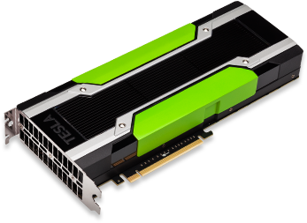
Next-Gen Roadmap Compute Virtual Machines (NC_v2)
 | NC6s_v2 | NC12s_v2 | NC24s_v2 | NC24rs_v2
Cores | 6 | 12 | 24 | 24
GPU | 1 x P100 | 2 x P100 | 4 x P100 | 4 x P100
Memory | 112 GB | 224 GB | 448 GB | 448 GB
Disk | ~700 GB SSD | ~1.4 TB SSD | ~3 TB SSD | ~3 TB SSD
Network | Azure Network | Azure Network | Azure Network | InfiniBand

Slide 25
Next-Gen Roadmap Deep Learning Virtual Machines (ND)
 | ND6s | ND12s | ND24s | ND24rs
Cores | 6 | 12 | 24 | 24
GPU | 1 x P40 | 2 x P40 | 4 x P40 | 4 x P40
Memory | 112 GB | 224 GB | 448 GB | 448 GB
Disk | ~700 GB SSD | ~1.4 TB SSD | ~3 TB SSD | ~3 TB SSD
Network | Azure Network | Azure Network | Azure Network | InfiniBand

Slide 26
Azure = True HPC on the cloud
Performance-tuned CPU and BIOS provide supercomputing-class VM performance to run jobs faster and reduce costs – no hidden hyper-threading!
Engineering in the platform enables Azure to deliver speeds comparable to (and sometimes better than) bare-metal hardware on premises
Azure is the only large cloud provider with InfiniBand RDMA networking and NVIDIA GRID license included for GPU workloads
Support for both Linux and Windows workloads
Multiple deployment options allow you to leverage existing technology investments

Slide 27
Why InfiniBand RDMA matters?

Slide 28
Architectures

Slide 29

Cloud burst: Using Azure IaaS
Add cloud resources to your cluster, on demand
On-premises
Compute nodes in the cloud
Burst to cloud to add resources when needed
Continue using your existing on-premises infrastructure
Run workloads on Windows and Linux, on Azure and on-premises
Cover peaks in demand or special projects
Pay only for what you use
Microsoft HPC Pack, Univa Grid Engine, and Altair PBS Pro already have this capability (and more are coming!)
Client
Head
node
Compute
nodes
Compute
nodes

Slide 30
Cloud clusters: Using Azure IaaS
Provision one (or more) new clusters in minutes
On-premises
All HPC resources in the cloud
Deploy a complete HPC cluster, all in the cloud, in just minutes
Use templates, scripts, and images to quickly deploy at any scale
Use your current HPC scheduler
Shift existing applications, scripts and tools to cloud
Deploy as many clusters as you need!
Head
node
Compute
nodes
Client

Slide 31


Cloud Workstations: Using Azure IaaS
Deploy powerful GPU-enabled workstations
On-premises
Remote workstations on the cloud
Deploy one or more GPU-enabled workstations on the cloud
Connect from any laptop or device (iOS, Android, Windows)
Collaborate, share, explore.
Run windows server 2016 or Linux OS
With or without optimized remote visualization platforms (e.g., Teradici PCoIP or Citrix HDX)
Tablet
NV
NV
NV
NV
NV
Zero
client

Slide 32
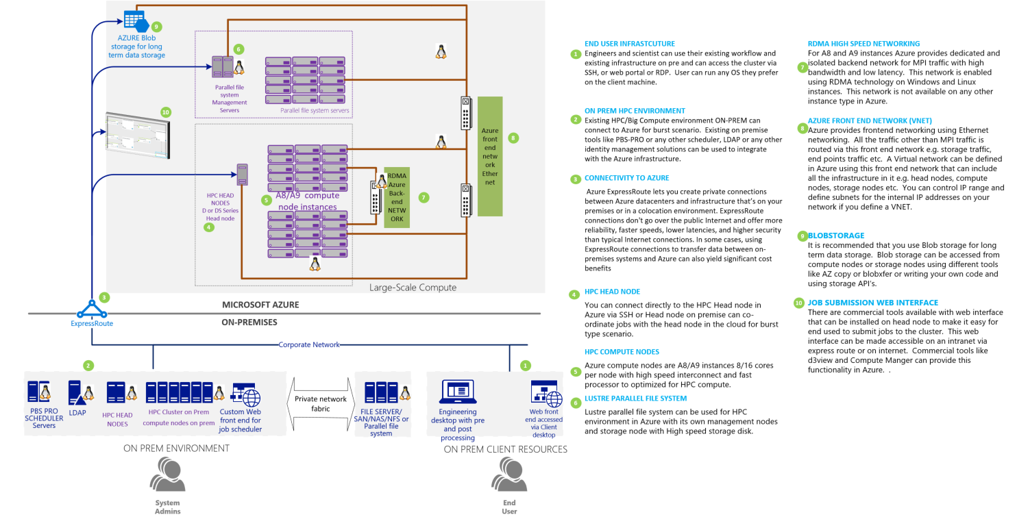
Azure Big Compute Architecture
Notes:
Non-blocking: have enough switch capacity such that we leverage full interconnect
Hardware capable of supporting Big Compute workloads
High CPU: 2x8 core processors per node, Sandybridge E-2670 at 2.6GHz
High memory—128GB, 1600MHz DDR3
Fast interconnect—QDR InfiniBand for intra node MPI traffic, 10gigE for standard Azure traffic and internet access
QDR in production for Windows & private preview for Linux RDMA
Scratch storage—2TB per node
Available in A8—8 core/56GB and A9—16 core/112GB instances
G series high end nodes available up to 32 cores with 448GB memory for both Linux and Windows
For I/O intensive applications non-MPI
A10 and A11 nodes without QDR rest of the configuration same as A8 and A9 (lower price point)
Refer to appendix for more benchmarks

Slide 33
Networking
Notes:
Q&A – This is a critical component of the ILL Format
Subject Matter Experts (preferably product group PM’s) on stage to answer questions
Note: It should be called out that Q&A can take place while attendees are walking through labs. This will work to facilitate providing attendees with the maximum amount of time to complete the lab

Slide 34
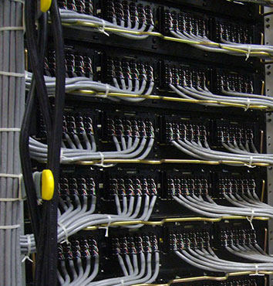
Azure Networking Infrastructure
MPLS connectivity
Intra node high bandwidth 20-30 Gbps
InfiniBand RDMA low latency 2.5-3.5 microseconds
Support for Intel MPI, Platform and MS MPI

Slide 35
Storage
Notes:
Q&A – This is a critical component of the ILL Format
Subject Matter Experts (preferably product group PM’s) on stage to answer questions
Note: It should be called out that Q&A can take place while attendees are walking through labs. This will work to facilitate providing attendees with the maximum amount of time to complete the lab

Slide 36

Azure Storage Infrastructure
Cloud scale object storage
Multi-protocol support – Blob, SMB, HDFS
Geo-redundant replication for DR
Hot, Cool and Cold storage tiers
Local SSD based scratch storage
POSIX based Parallel file system Lustre, BeeGFS

Slide 37
Azure storage services
IaaS
PaaS
Virtual machines
Existing frameworks
Web and mobile
Microservices
Serverless Compute
Storage
Networking
Disks
Persistent disks for Azure IaaS VMs
Premium Storage Disks option: SSD based, high IOPS, low latency
Files
Fully Managed File Shares in the Cloud
SMB and REST access
“Lift and shift” legacy apps
Blobs
Highly scalable, REST based cloud object store
Block Blobs: Sequential file I/O
Cool Tier Available
Page Blobs: Random-write pattern data
Append Blobs
Client side HDFS
Tables
Massive auto-scaling NoSQL store
Dynamic scaling based on load
Scale to PBs of table data
Fast key/value lookups
Data Lake
Unlimited storage for HDFS based apps
Unlimited size accounts and objects
Built on Blob storage
Server side HDFS
Built on a unified Distributed Storage System
Durability, Encryption at Rest, Strongly Consistent Replication, Fault Tolerance, Auto Load-Balancing
Notes:
Cloud services and cloud usage are broadly defined as existing across infrastructure services or IaaS and higher layer platform services or PaaS. The Azure Storage services span both categories.
On the IaaS side we provide single instance storage for VMs in the form of our Disks service and SMB shared storage which we call Azure Files.
On the PaaS side we provide an unstructured object store called the Blob Storage service which offers Exabyte scale and the ability to store trillions of objects across different tiers within the cloud. Our current cloud object storage tiers are hot storage for higher performance and frequently accessed data and cool storage for active archives. In addition to unstructured data, we also have the NoSQL Tables service for semi-structured and structured data and the Queues service for reliable intra and inter-service communication.

Slide 38
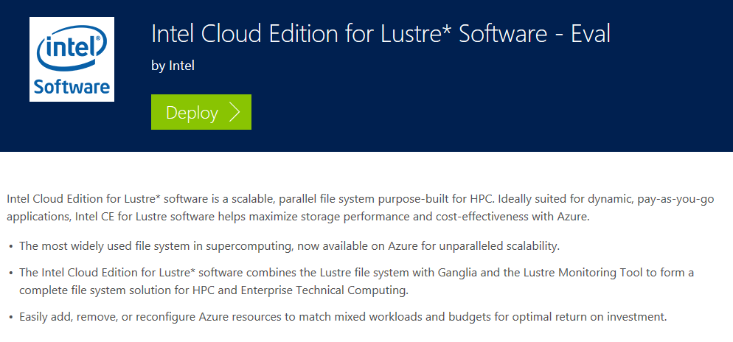
Shared Storage: Lustre, Bee-GFS or NFS
Leverage Premium Storage with Ds series VMs with P30 disk
Ready to deploy ARM template that can launch 1600 core cluster in 10 minutes
Create large storage volumes shared across single name space
https://azure.microsoft.com/en-us/marketplace/partners/intel/lustre-cloud-edition-evaleval-lustre-2-7/

Slide 39
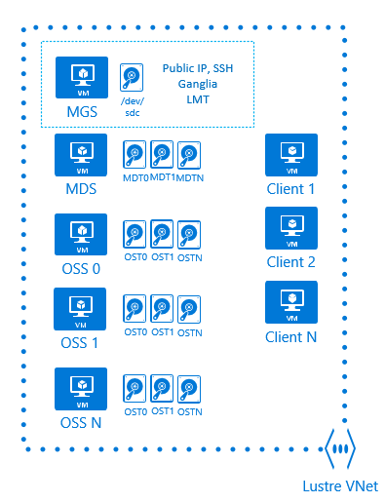
Intel Cloud Edition for Lustre* Architecture on Azure
Azure gallery CentOS 6.6
Lustre 2.7 pre-built kernel
ARM template for MGS, MDS, and “N” OSS nodes
Bash Linux script extension for configuring the nodes
ARM template for Lustre clients within existing VNet

Slide 40
Compare to Azure Storage
Azure Storage Blobs
Azure File Storage
Azure Data Lake Store
Lustre on Azure VMs
Object storage:
no “mount” from Linux
limited access from existing filesystem tools
block/page level access
Max blob size:
200GB block blob
1TB page blob
For standard storage max throughput is 60MB/s per blob and 500 IOPS
Managed as-a-service Highly Available (HA)
SMB 3.0 as-a-service:
“mount” from Windows and many Linux distros
not from CentOS 6.x
Max size of share is 5TB
Max size of a file is 1TB
Max throughput for the whole share is only 60MB/s
Managed as-a-service
HA
WebHDFS:
compatible with HDFS
works with Hadoop ecosystem (e.g. MR, Hive)
access from HDInsight
no “mount” from Linux for use with existing filesystem-based tools
“Unlimited” petabyte file sizes and high-throughput since files are spread
Managed as-a-service
HA
POSIX storage:
standard IO functions
standard Linux tools
byte-level access
More expensive (compute, premium storage)
Max file size and performance depends on number of OSS and OST servers
Durable storage, but in current version, no HA in Azure for compute nodes

Slide 41
Microsoft Azure Enterprise NFS Service, Powered by NetApp
For the first time, Microsoft will deliver a native, first-party Enterprise Network File System (NFS) service based on NetApp’s proven ONTAP® technology.
http://www.netapp.com/us/products/cloud-storage/microsoft-azure.aspx

Slide 42
Overview of Hands-on Workshop
Notes:
Q&A – This is a critical component of the ILL Format
Subject Matter Experts (preferably product group PM’s) on stage to answer questions
Note: It should be called out that Q&A can take place while attendees are walking through labs. This will work to facilitate providing attendees with the maximum amount of time to complete the lab

Slide 43
Workshop environment
This is an Azure Workshop. You are welcome to use your own Azure Subscription if you have one. If you don’t, then you can use the pre-activated subscription provided.
For the majority of the time, the only thing we will be using on the machine is the Browser.
The step-by-step instruction manual is available at this address:
https://techcadill300.blob.core.windows.net/docs/TECH-CAD-ILL300.docx
If time permits, we will learn how to enable the BASH on Ubuntu on Windows 10.
Notes:
Lab & Virtual Machine Environment Details (5 minutes)
Introduce machine configuration details (What is loaded on each machine?)
Introduce relevant networking configuration details between VMs.
It is extremely important that the audience have a context of what the lab architecture is before diving into the exercises.
Call out the fact that we have ‘ILL Technical Subject Matter Experts’ in the room to help attendees with labs.

Slide 44
Definitions
Term | Definition
MPI | Message Passing Interface – a standardized and portable message-passing system for tightly coupled parallel jobs
Infiniband | Very high bandwidth, low latency network to facilitate MPI traffic.
RDMA | Remote Direct Memory Access – Device drivers which enable the Virtual Machines to reach through the Hypervisor to communicate with the Infiniband network interface
Availability Set | A designation which informs the Azure Fabric to provision the VM’s across separate maintenance and fault domains

Slide 45
Prerequisites for running MPI jobs on Azure https://docs.microsoft.com/en-us/azure/virtual-machines/linux/classic/rdma-cluster
Sufficient core quota for Infiniband equipped VM types
A8/A9, H16R, H16MR
Jobs must be < 3200 cores due to current Availability Set limitation
All VM’s running an MPI job must belong to the same Availability Set
Current upper limit is 200 VM’s X 16 cores = 3200 cores
The OS image must contain the RDMA drivers
Currently includes Windows, CentOS-HPC, and SLES 12 SP1 for HPC
Must use Intel MPI (Open MPI is not supported)
Setting appropriate environment variables is critical
All nodes must be able to communicate via password-less “ssh”
If connected with a VPN, there must not be any conflicts with the 172.16.0.0/16 address range which is hard coded for the Infiniband

Slide 46
Before Managed Disks

Slide 47
With Managed Disks

Slide 48
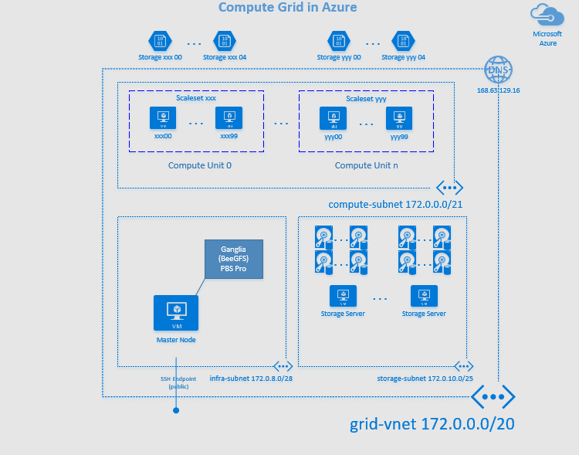

Slide 49
Deployment Methods
Notes:
Q&A – This is a critical component of the ILL Format
Subject Matter Experts (preferably product group PM’s) on stage to answer questions
Note: It should be called out that Q&A can take place while attendees are walking through labs. This will work to facilitate providing attendees with the maximum amount of time to complete the lab

Slide 50
Resource Groups
Tightly coupled group of
multiple resources
Lifecycle,
Identity,
Tags
Unit of management
Access Control
Billing
RESOU
R
CE G
R
OUP

Slide 51
Deployment Options
PowerShell https://docs.microsoft.com/en-us/azure/virtual-machines/windows/quick-create-powershell?toc=%2Fazure%2Fvirtual-machines%2Fwindows%2Ftoc.json
CLI https://docs.microsoft.com/en-us/azure/virtual-machines/windows/quick-create-cli
Terraform by HashiCorp https://azure.microsoft.com/en-us/blog/investing-deeply-in-terraform-on-azure/
Ansible https://www.ansible.com/microsoft-azure

Slide 52
ARM Templates
Notes:
Q&A – This is a critical component of the ILL Format
Subject Matter Experts (preferably product group PM’s) on stage to answer questions
Note: It should be called out that Q&A can take place while attendees are walking through labs. This will work to facilitate providing attendees with the maximum amount of time to complete the lab

Slide 53
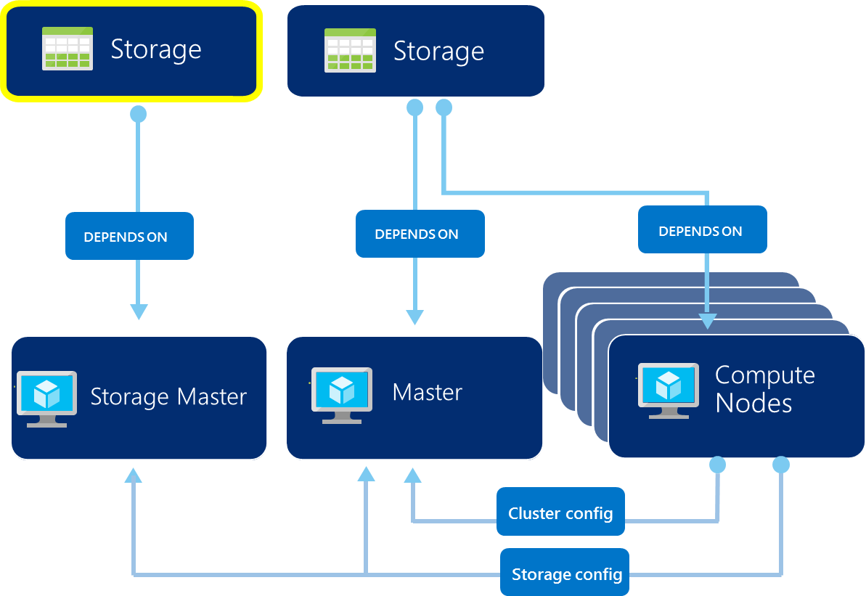
ARM Templates
JSON file that describes an entire environment for deployment.
“Infrastructure as Code”
Source file, checked-in
Specifies resources and dependencies and connections
Parametrized input/output
An entire HPC cluster can be
defined in a single JSON Template
and deployed in one operation
Power of Repeatability
Fast deployment

Slide 54
Github Repositories for Big Compute Environments
https://github.com/grandparoach/simpleMPIPOC/tree/Ready
https://github.com/xpillons/azure-hpc/tree/master/Compute-Grid-Infra
https://github.com/tanewill/AHOD-HPC
https://github.com/smith1511/hpc
https://github.com/mkiernan/FlexHPC

Slide 55
Azure Portal / Cloud Shell
Notes:
Q&A – This is a critical component of the ILL Format
Subject Matter Experts (preferably product group PM’s) on stage to answer questions
Note: It should be called out that Q&A can take place while attendees are walking through labs. This will work to facilitate providing attendees with the maximum amount of time to complete the lab

Slide 56
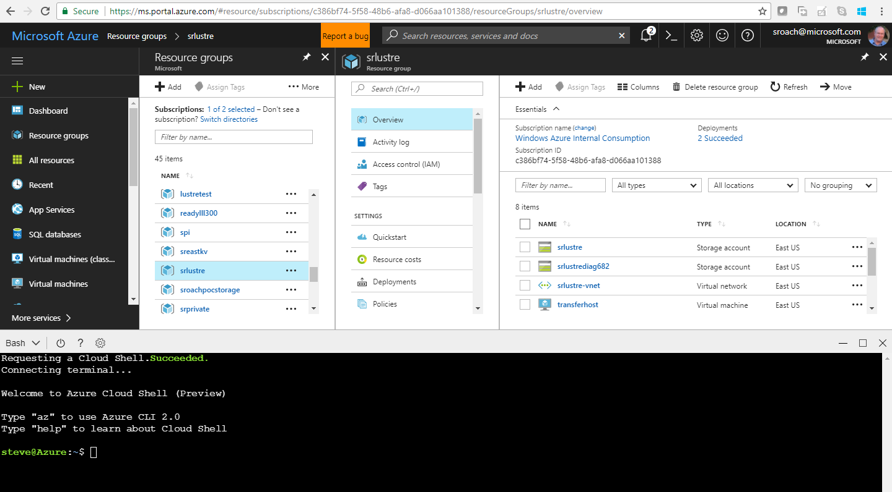

Slide 57
Azure Batch Scenarios
Notes:
Q&A – This is a critical component of the ILL Format
Subject Matter Experts (preferably product group PM’s) on stage to answer questions
Note: It should be called out that Q&A can take place while attendees are walking through labs. This will work to facilitate providing attendees with the maximum amount of time to complete the lab

Slide 58
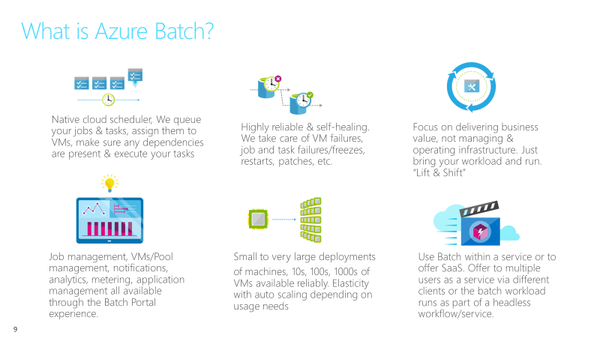

Slide 59
Task Execution Pattern on Azure
User application or service
Get and manage VMs
Install task applications
Significant amount of infrastructure, not related to business
Manage and authenticate users
Start the tasks
Move task input and output
Queue tasks
Task failure? Task frozen?
Scale up and down
IaaS or PaaS
Standard and custom images
Windows or Linux
PaaS
Cloud Services
IaaS
Virtual Machines
Commodity to high-performance
Small to huge
RDMA network for tightly coupled tasks
Hardware
Notes:
If you do it yourself, without a service like Batch, you must do all that is on the higher layers (white boxes). HPC Pack helps with some, but not all of those steps, and you still need to manage things from the cluster head node (e.g., add and remove users, run tasks and check their status, etc.)

Slide 60
Azure Batch: Job Scheduling as a Service
User application or service
Azure Batch
Cloud-enable applications, made available as SaaS:
Higher-level set of capabilities
Minimizes required Azure knowledge
App lifecycle, job dependencies, data movement, client plugins
Azure Batch
Foundational batch processing service
Don’t worry about the “plumbing”
VM management and job scheduling
VM management, job queue, and task dispatch
PaaS
Cloud Services
IaaS
Virtual Machines
Hardware
Notes:
With Azure Batch, you can forget about the infrastructure and the scheduling (you can “leave the plumbing to us”) and focus on your app or service instead. There are two models:
When you just leverage the foundational capabilities for VM provisioning and job/task scheduling. In this model, you enable the app and write the code to run it, to manage users, handle quotas, etc.
→This model is attractive to ISVs and SIs, especially if they already have their own SaaS portal. Could be attractive as well to organizations that have SaaS enable through their own platform already
If you want leverage the additional capabilities of Azure Batch around app, you can focus on your workload while Batch helps you with app lifecycle (add, update and retire apps), job dependencies and flow, moving data for jobs and tasks to use, adding and removing users and groups, assigning user roles, setting quotas and limits for users and groups, and plugging in directly into client apps
→This model is most attractive to organizations (small or large) that want to enable one or more apps as service quickly

Slide 61

Batch Developer flow
Azure Batch
Account
Endpoint URL
Meters
User Certificates
Create an account “mybatchservice”
https://mybatchservice.batch.core.windows.net
AddPool(…)
Static Config
AddJob(…)
Pool
Work Item
Pool name; existing or auto-create
Schedule
Priority
Blob
T
T
Upload programs & dependencies
A
Applications & dependencies
A
D
A
A
D
Job created when Work Item scheduled
Admin
D
Data
T
A
A
A
D
Job
Specify resources
VM Size
Target # instances
Start Task (inc. file list)
Auto Scale Formula
Allow communication?
AddTask(…)
Task
Command line
File list
Environment settings
State
Stats
Application / Service
Define and submit work
Queued, allocated,
executed
Monitor status
VM
A
Application(s)
D
Data
T
Task

Slide 62
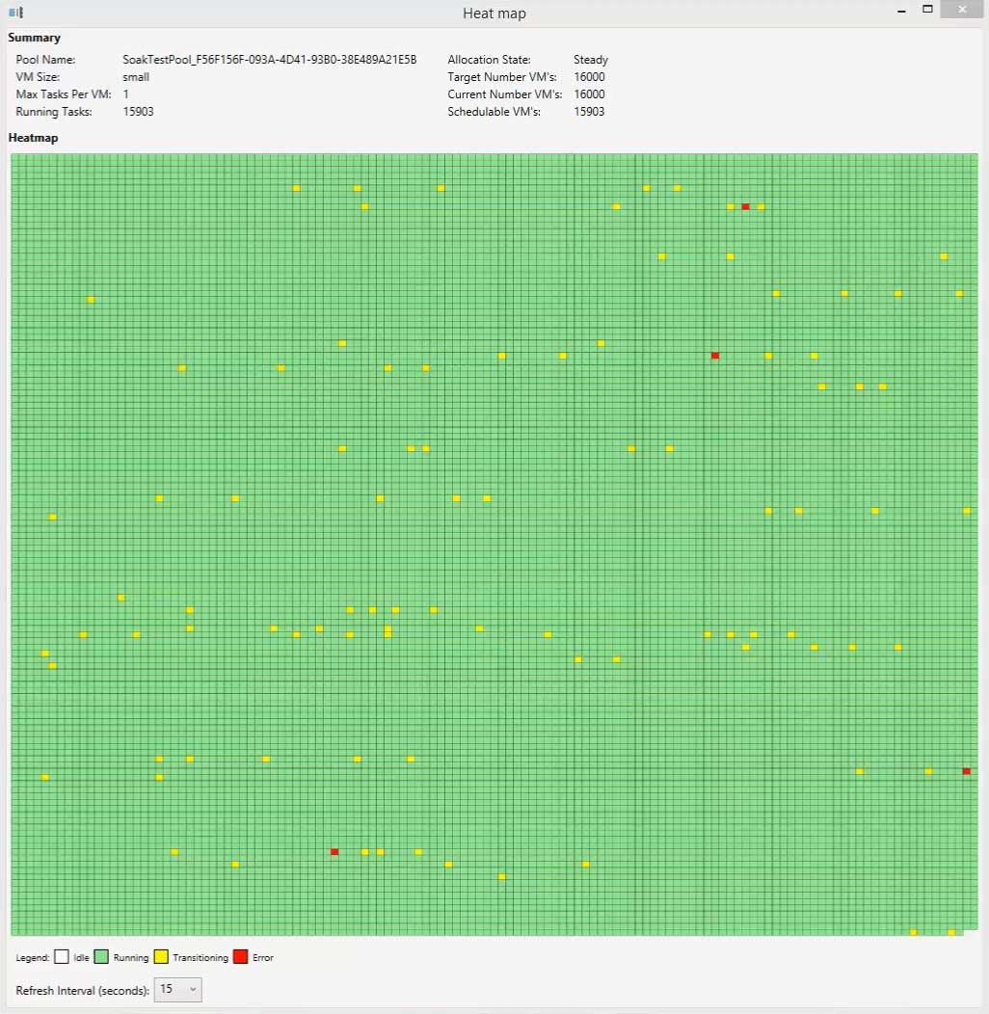
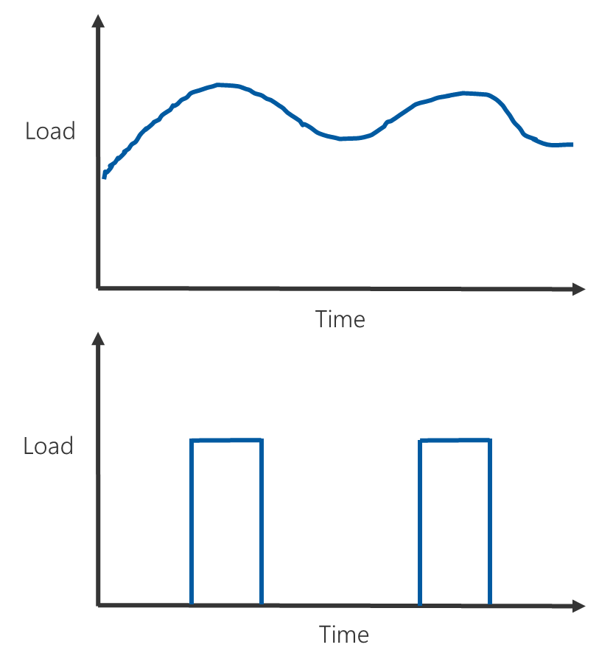
Elasticity & Scale
https://blogs.endjin.com/2015/07/spinning-up-16000-a1-virtual-machines-on-azure-batch/
What would you do with 100,000 cores? - Big compute at global scale
https://azure.microsoft.com/en-us/blog/what-would-you-do-with-100000-cores-big-compute-at-global-scale/

Slide 63
New: Low-Priority VM’s
Significantly lower priced compute
Up to 80% discount compared to on-demand price - fixed price
All Batch VM sizes and regions
Uses surplus capacity; availability could vary; VMs could be preempted
Suitable workloads
Distributed parallel jobs - many discrete tasks, interrupt tolerant, shorter task execution times, flexible job completion time
e.g. Dev, test – regression, scale, load
Value
Get work done for lower cost, faster, or do more for same price

Slide 64
Azure Batch Support for Low-Priority
Batch Pools:
Contain low-priority and/or dedicated VMs
Scale low-pri & dedicated independently
Job doesn’t need to know about VM mix
Preemption handling:
Interrupted tasks are re-queued
Pools automatically seek to target
// Create a Pool
CloudPool pool = PoolOperations.CreatePool (“Pool1”, “Standard_D14_v2”, vmConfig);
pool.targetDedicatedComputeNodes = 20;
pool.targetLowPriorityComputeNodes = 80;
pool.Commit();
// Get Pool info
CurrentDedicated = pool.CurrentDedicatedComputeNodes;
CurrentLowPriority = pool.CurrentLowPriorityComputeNodes;
// Resize Pool – no dedicated, all low-priority
pool.Resize(0, 100);

Slide 65
Who’s using Azure Batch?
Azure Media Services
Azure Engineering
Windows Update
Microsoft Hardware Teams
Boeing
Towers Watson
Societe Generale
AXA
Pure Auto
TV Everywhere

Slide 66


Low Priority VMs – Use Case
Develop tools for data-driven diagnostics
cMRI provides quantification of MR brain scans
Use Batch for large-scale image processing
Using low-priority VMs for:
Algorithm development and testing against subset of data
Final test passes against full set of data
Value of low-priority VMs:
Large reduction in dev/test cost overhead
More frequent test passes finds issues earlier

Slide 67
Example Use Case – Azure Media Services
Work:
On-going submission of encoding jobs by users
Tasks queued and executed when VM’s are available
Azure Media Services
Azure Batch
Resources:
Allocate VM’s for encoding
Install encoding software; e.g. Expression Encoder
Number of VM’s adjusted to cater for varying load
A
A
A
A
T
T
T
T
A
A
A
A
VM
T
T
A
Application(s)
T
Task

Slide 68
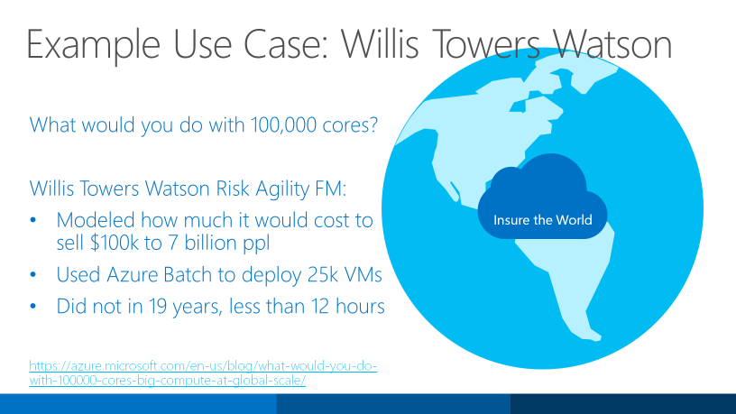

Slide 69
Batch Opportunities in Addition to “HPC”
Media transcoding
Media Services - audio and video transcoding, etc.
ISV – video transcoding using ffmpeg
XBox video – video pre-processing
Rendering
HoloLens team renders test scenes with Blender
ISV rendering plug-in for 3DSMax and V-Ray
Test execution
Azure Engineering CloudValidate service
Intune runs 20K tests in 20 mins following check-in’s
Monte Carlo simulations
Python, C#, C++, etc.
Insurance risk analysis
Energy pricing, hotel room pricing
Employee pension plan savings analysis
Deep Learning
Training and evaluation
Genomics:
Microsoft Genomics service
OCR:
Use Tesseract to process document images
Data ingestion and processing / ETL
StorSimple ingest and pre-process for HDInsight jobs
Nightly data ingestion and process automotive data
ADF data copy activities
R
Baseball team - player stats
Financial services
MATLAB:
MATLAB clusters
Compiled MATLAB scaleout
Simulations
Engineering ISV customers can run apps at scale
Aircraft route optimization
Image processing
Analyze MRI scans for signs of disease
Analyze blood samples

Slide 70
Doing Things with Batch
Solutions
Batch AI Training
Batch Rendering
Accelerators
Batch doAzureParallel for R
Batch Shipyard recipes

Slide 71
New: Azure Batch AI Training
Managed service that enables you to easily train, test, and evaluate deep learning and other AI models
Work with clusters of GPUs to run experiments in parallel and scale to massive models and data sets
Tell us what program to run, where to run it, any parameters, and how many instances in parallel

Slide 72
Train and Deploy Custom AI End-to-End
CNTK, TensorFlow, Chainer…
Python, Visual Studio,
Spark…
Azure Batch AI Training
Azure Machine Learning
Azure Data Lake
SQL Server
Your Data
With Any AI Tools
+
Training With Scale-Out
GPU Clusters on Demand
=
Intelligence In Your
Apps and Data Services

Slide 73
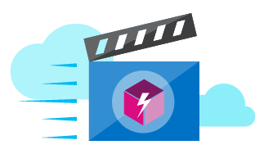



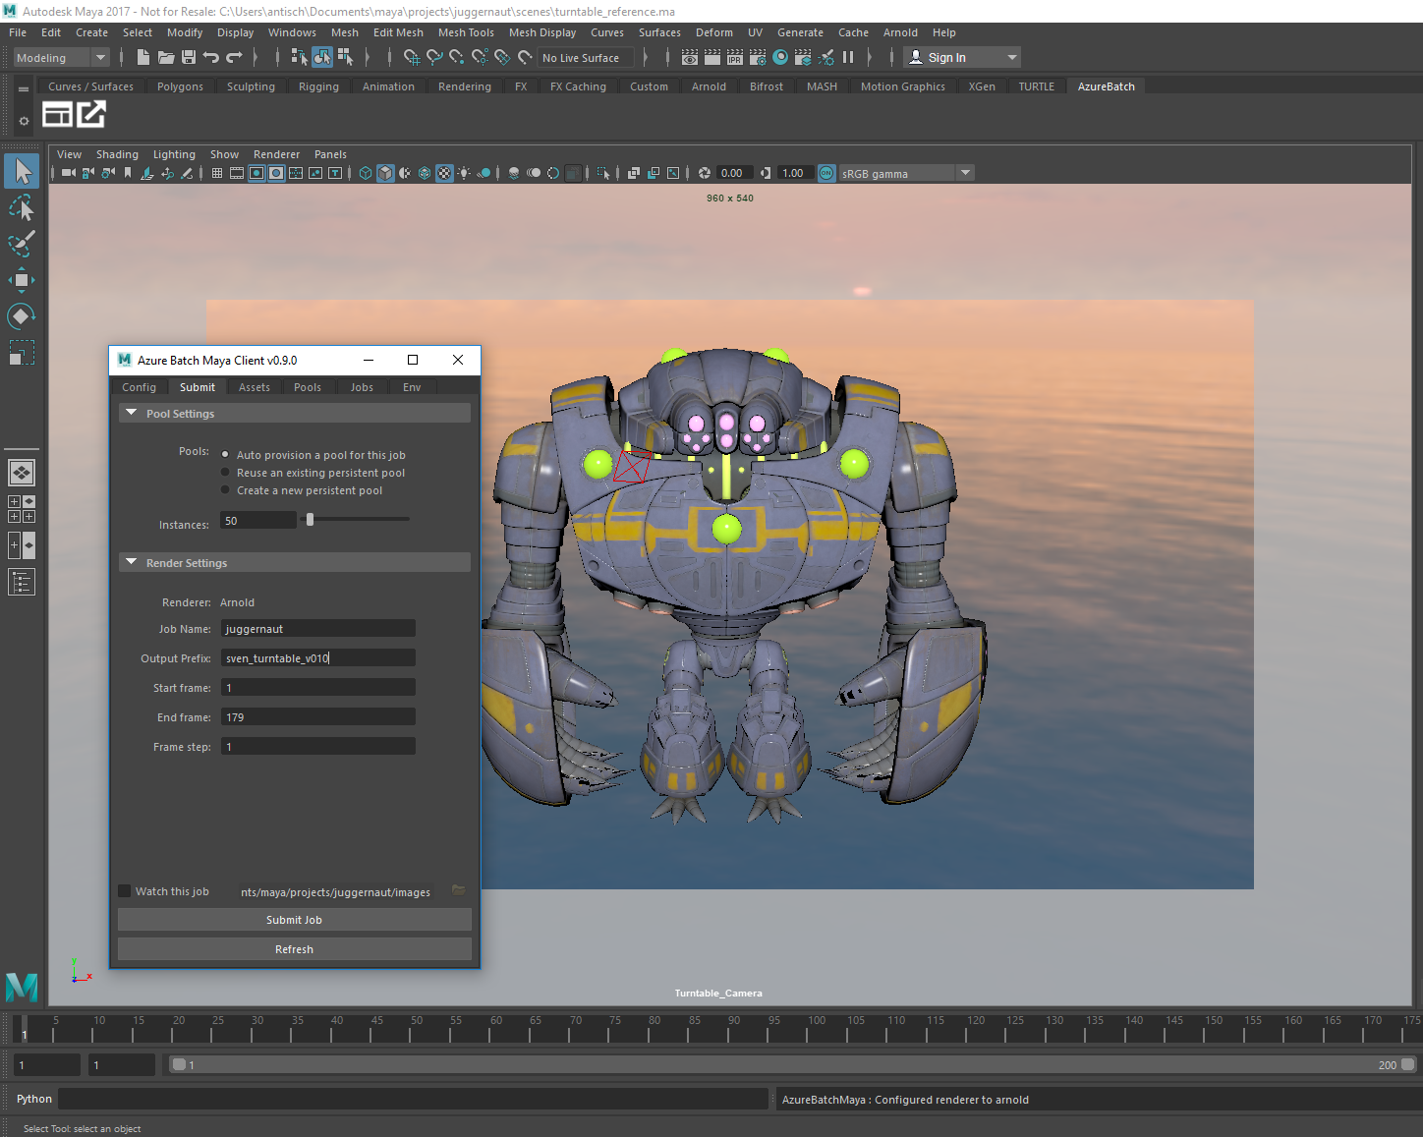

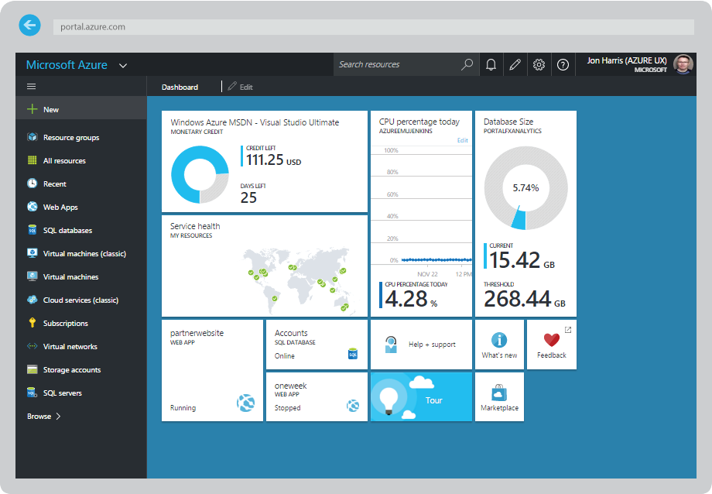
Batch Rendering
Azure Batch
Autodesk 3ds Max / Maya
Integrated Client Plugin
Upload assets
Submit job
VM
VM
VM
Return outputs
Renderer
Renderer
Renderer
Monitoring
Reporting
Single bill

Slide 74
doAzureParallel
Offload parallel R functions with 5 lines of code
Demo and example of Batch in an end-user app
Download and install from www.github.com/Azure/doAzureParallel
Great for hackathons

Slide 75

Batch Shipyard
Tool to help provision and execute batch processing, HPC, and AI Docker workloads on Azure Batch compute pools
Run Dockerized tasks with simple configuration files
Built on Python
Open source community project
Get ideas out for feedback and to unblock customers
Features may move into Batch Service and SDK
https://github.com/Azure/batch-shipyard

Slide 76
Major Batch Shipyard Features
Docker Host Engine installation tuned for Azure Batch and images deployed to nodes with support for private registries, including Azure Container Registry
Data movement for jobs between locally accessible storage systems, remote filesystems, Azure Blob or File Storage, and compute nodes
Standalone remote filesystem provisioning and auto-linking these filesystems to compute nodes with support for NFS and GlusterFS distributed network file systems
Full pass-through of the Batch API to Docker containers executed on compute nodes allowing complex processing pipelines and DAGs
Transparent support for GPU and InfiniBand/RDMA to Docker containers with automatic setup
Multi-instance tasks for Dockerized MPI and multi-node cluster applications with automatic job completion and Docker task termination
Automatic setup of SSH users to all nodes and optional tunneling to Docker hosts
Azure Function App integration and support as an execution target for triggers

Slide 77

Things to Keep in Mind
http://www.flickr.com/photos/mwichary/4062776435/in/set-72157622706796148

Slide 78
Data Movement and Patterns
Need to think about scaling both compute and storage
Managing custom images (scale sets will be making this easier)
Distribute one file to many
Write many VMs to one share
Handling large files (block blobs)
Tools
Create multiple storage accounts
Spread out the first letters of storage account names as much as possible
Consider premium storage
Intel Lustre parallel file system or gluster from RedHat

Slide 79
Pricing Models
Customer goal: Lowest blended cost and most flexibility
On-Demand
Reservations (discount and SLA)
Low priority (spot)—Coming first for Batch

Slide 80
Q&A
Notes:
Q&A (10 minutes – again duration may vary by session) - This is a critical component of the ILL Format
Subject Matter Experts (preferably product group PM’s) on stage to answer questions
Note: It should be called out that Q&A can take place while attendees are walking through labs. This will work to facilitate providing attendees with the maximum amount of time to complete the lab

